Slide 1

WELCOME
COHORT 5
7th Sept – 3rd Dec 2026
Suite 6-6-7, Level 6, Menara MAA

Slide 2

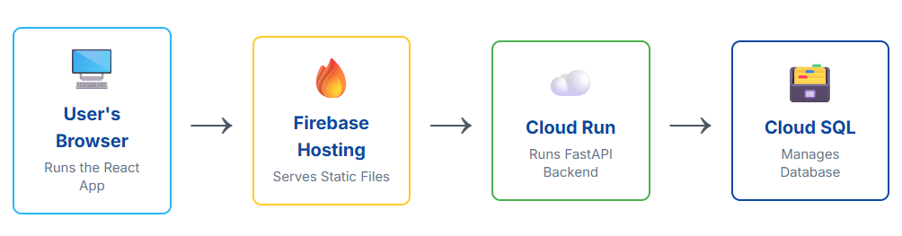
Contents
Introduction to Firebase
Frontend deployment into serverless live URL

Slide 3
What is Firebase?
It's a Backend-as-a-Service (BaaS) platform by Google.
Think of it as a toolkit for building web and mobile apps without managing servers.
It handles the complex server-side infrastructure, so you can focus on building amazing user experiences.
Other static site hosting services – Vercel, Netlify, Github Pages, Supabase etc.

Slide 4
Why Firebase?
Speed: Go from localhost to a live, shareable URL in minutes.
Simplicity: The tooling is incredibly intuitive.
Cost-Effective: The "Spark Plan" (free tier) is extremely generous for personal projects and prototypes.
Scalability: It's built on Google Cloud infrastructure. Your app can handle millions of users without you changing a thing.
It's more than just hosting: Firebase is part of Google Cloud ecosystem (database, auth, storage, Vertex AI, etc.) that seamlessly integrates with your frontend.

Slide 5
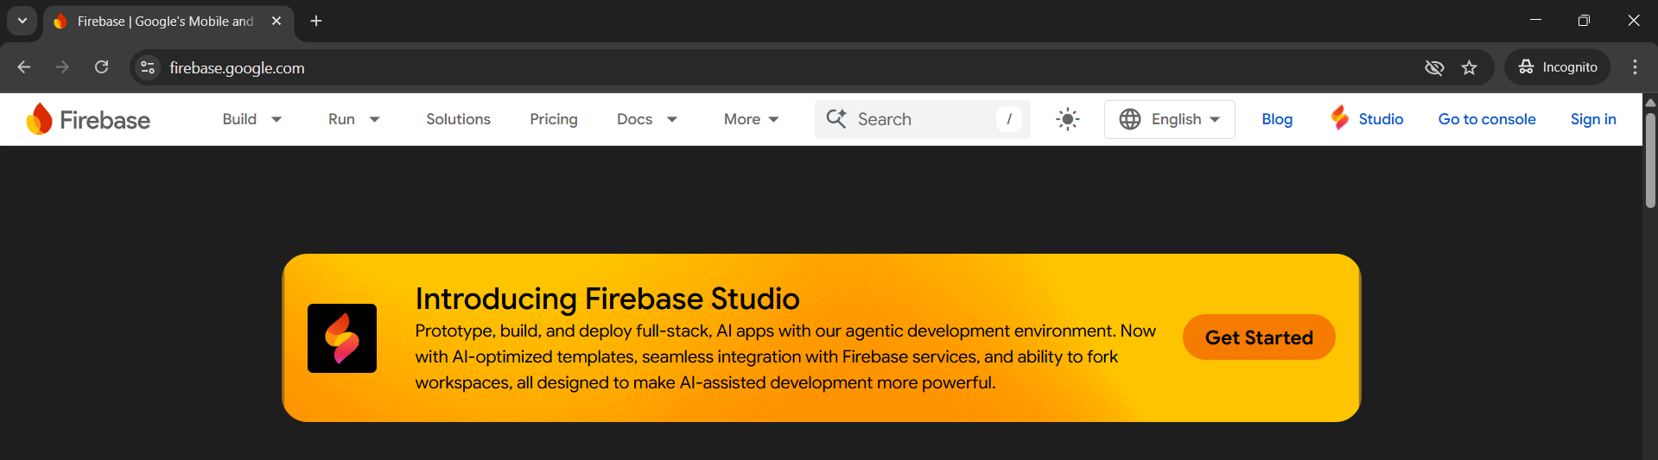
Setup Firebase
Visit https://firebase.google.com/
Click “Sign In” button (register with your google account).
Go to console.

Slide 6
Create a New Firebase Project
In the Firebase console, Add project by clicking on “Get started by setting up a Firebase Project” .
Give your project a unique name (e.g., bookstore-app).
Click "Create project".

Slide 7
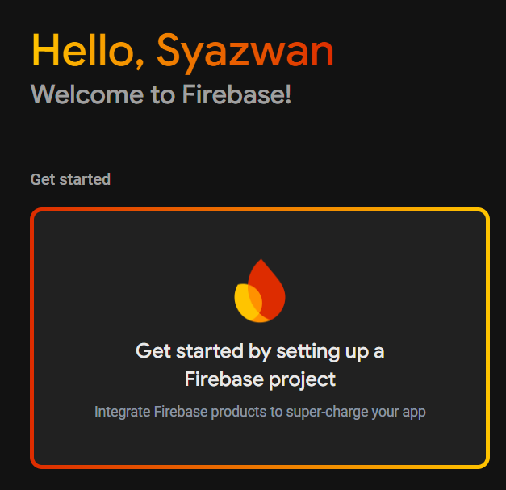
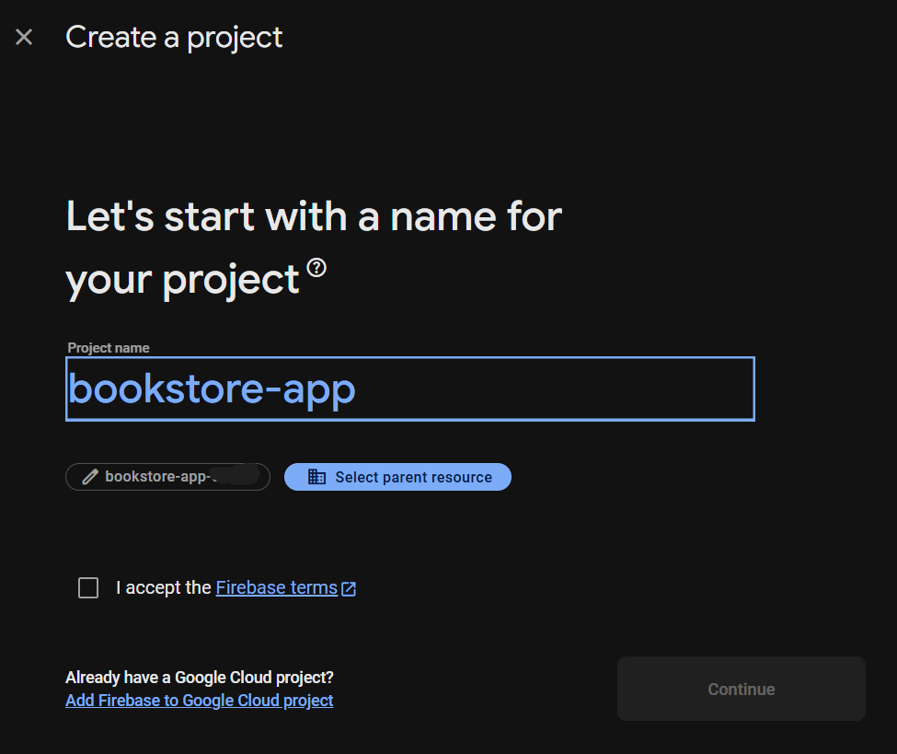
Create a New Firebase Project

Slide 8
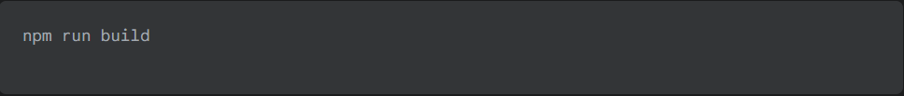
The build Command
In development, npm run dev starts a local server with hot-reloading. This is great for us, but not for users.
For production, we need to package our app into a small, optimized set of static files.
This is what npm run build does.
Vite will create a new dist folder in your project. This folder is your entire application, ready to be deployed.

Slide 9
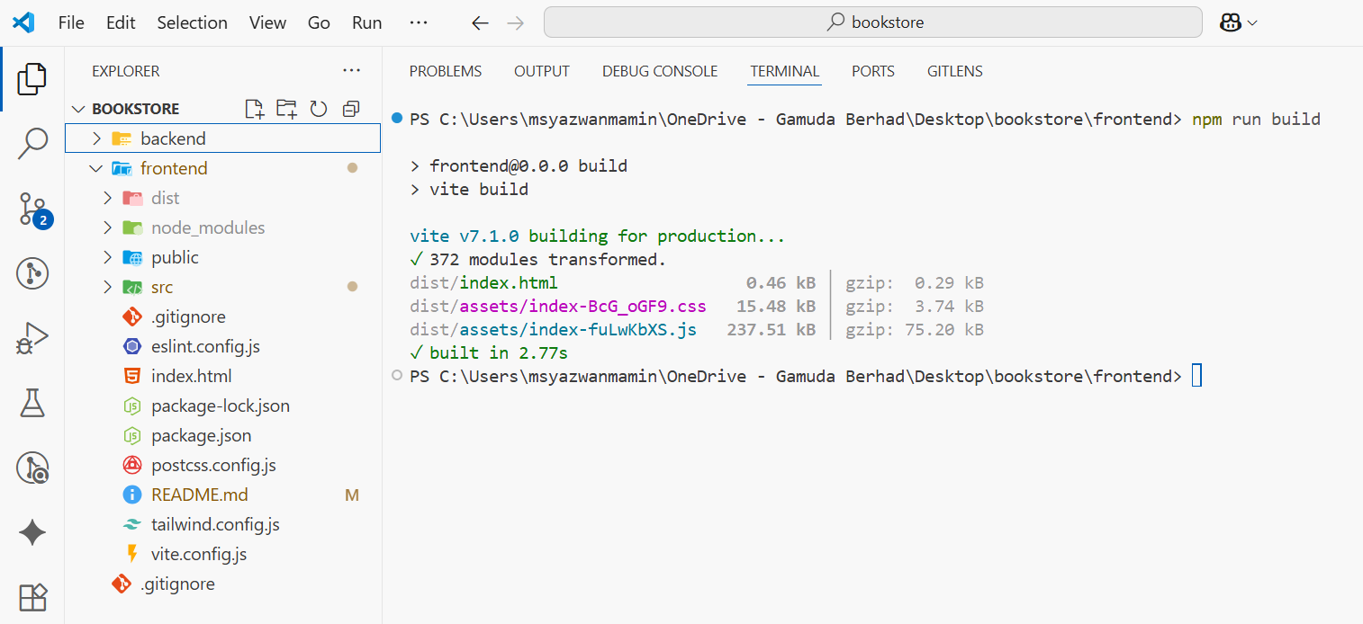
The build Command
New dist folder created with build command

Slide 10
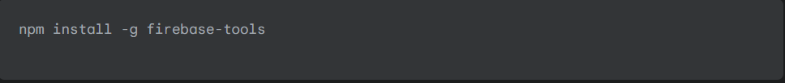
Hands-On Deployment
Step 1: Install the Firebase CLI
This command makes the firebase tool available anywhere or globally on your system.
Run the command below in your terminal:

Slide 11
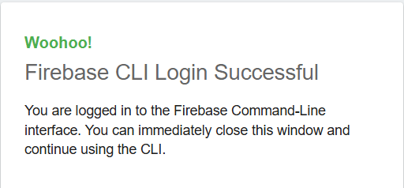
Hands-On Deployment
Step 2: Log into Firebase
Next, we need to connect the CLI to our Firebase account.
Run the command below in your terminal:
This will open a Google login window in your browser. Grant the requested permissions to proceed.

Slide 12
Hands-On Deployment
Step 3: Initialize Firebase
Navigate to the root of your React project.
Run the command below in your terminal:
Answer these Questions in your terminal:
Which features? → Hosting: Set up deployments for static web apps
Project Setup? → Use an existing project
Public directory? → dist (This is the most important step!)
Configure as a single-page app? → Yes (Critical for React Router)
Set up automatic builds with GitHub? → No (We'll deploy manually today)

Slide 13
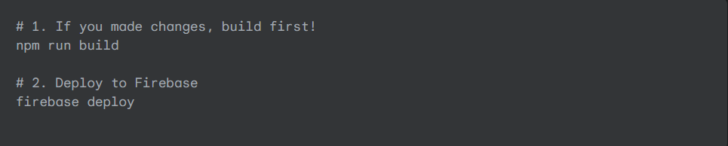
Hands-On Deployment
Step 4: The Final Command: deploy
Time for the grand finale. Make sure you've built your app first!
Run the command below in your terminal:
The CLI will upload your dist folder. After a few seconds, you'll get a success message with your live Hosting URL.

Slide 14
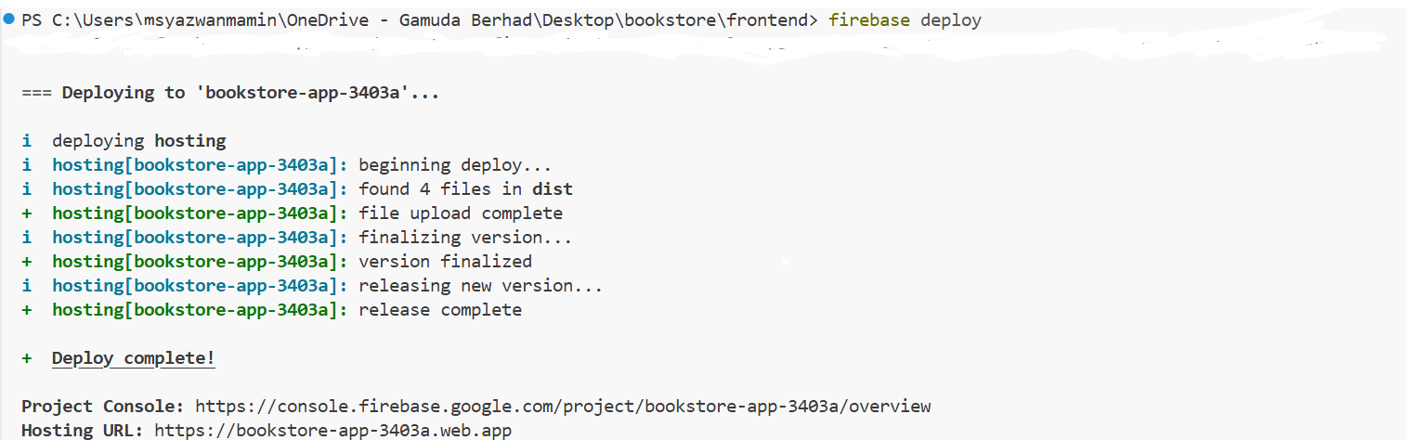
Hands-On Deployment
Congratulations! Your React application is now live!
Troubleshooting Tip:
If you deploy and still see the default "Welcome to Firebase" page, go to your Project Settings in the Firebase Console. Under "Your apps", click "Add app" and select the web icon (</>). Give it a nickname and register the app. You do not need to add the SDK scripts to your code, but this registration step can solve deployment issues.

Slide 15
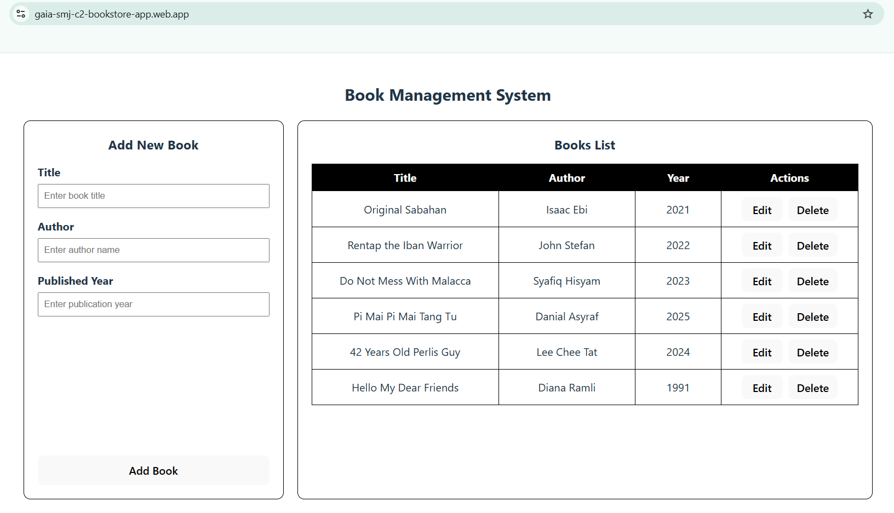
Deployed Frontend with Live URL
Start your backend server to test HTTP methods by running uvicorn in your terminal since there is no deployment yet for backend.

Slide 16
Recap
We learned what Firebase is and why it's great for frontend developers.
We set up a Firebase project from scratch.
We used the Firebase CLI to connect our local code to our cloud project.
We configured our project for hosting a React single-page app.
We deployed (and redeployed) our app to a live URL.

Slide 17
Exercise
Configure and deploy your capstone project react + vite App frontend with URL format (project name) as below:
https://gaia-sabah-c2-`group#`-`name`.web.app/
Example: https://gaia-sabah-c2-group3-khaizul.web.app/
*Submit your deployed firebase hosting URL in Gdrive folder.

